Slide 1

Bookmarks & Field Parameters 101
Allan Khariton – Sr FP&A Analyst

Slide 2







Thank you to our sponsors!

Slide 3
Why are bookmarks & parameters important?
Bookmarks and field parameters:
Maximize your report’s interactivity by giving users greater flexibility
Reduce report complexity and maintenance for developers
When used together, they provide multiple reporting perspectives on a single page with a streamlined user experience

Slide 4
What are bookmarks?
Bookmarks save a report’s current filters, visibility, cross-highlighted visuals, and sort order.
When you add bookmarks to a report, users can get back to that exact view by selecting it

Slide 5
Benefits of using bookmarks in your reports
Improved navigation
Show/hide content
Guided storytelling
Customized views
Reduced report clutter
Notes:
Improved navigation – Create app-like experiences with buttons and menus.
Show/hide content – Display different visuals, explanations, or drill-through experiences without leaving the page.
Guided storytelling – Walk users through key insights in a controlled sequence.
Customized views – Provide different perspectives for different audiences while keeping everything on the same page.
Reduced report clutter – Instead of placing every visual on the screen at once, show only what's relevant when users need it.

Slide 6
Bookmark Tips & Tricks
Group relevant visuals in the Selection pane
Group your bookmarks in the Bookmarks pane
Use bookmark properties effectively
Data
Display
Current Page
All/Selected Visuals
Keep accessibility in mind with Tab Order in the Selection Pane

Slide 7
What are field parameters?
Allow users to dynamically switch which dimensions or measures are displayed in visuals
Allow users to group measures so they can toggle displayed columns

Slide 8
Benefits of using field parameters
Self-service analysis
Greater report flexibility
Consistent user experience
Scalability
Fewer visuals to maintain
Notes:
Self-service analysis – Users can choose which metric or category they want to analyze.
Fewer visuals to maintain – One chart can serve the purpose of many.
Greater report flexibility – Users can change axes, measures, and comparisons without needing separate pages.
Consistent user experience – Keeps formatting and interactions intact while changing the underlying fields.
Scalability – Easier to expand report functionality as business requirements evolve.

Slide 9
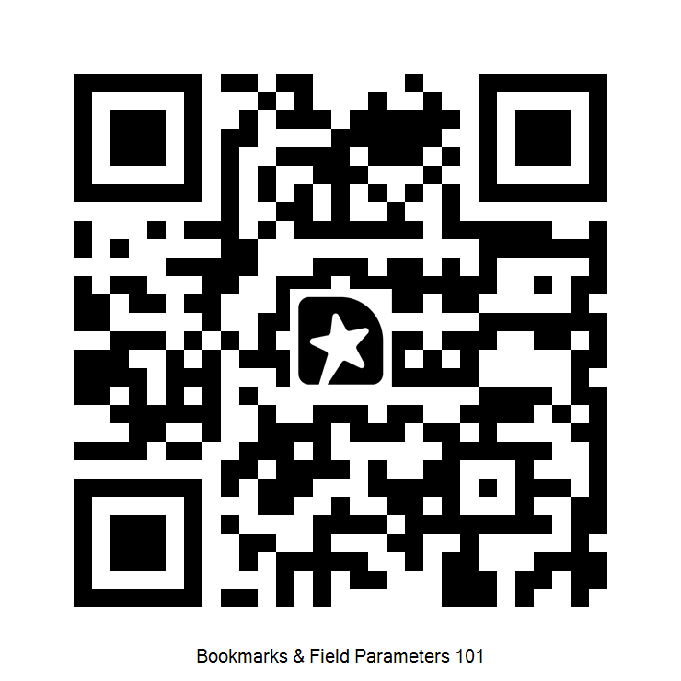
Feedback and Links
GitHub Link
Feedback Link

Slide 10
Appendix

Slide 11
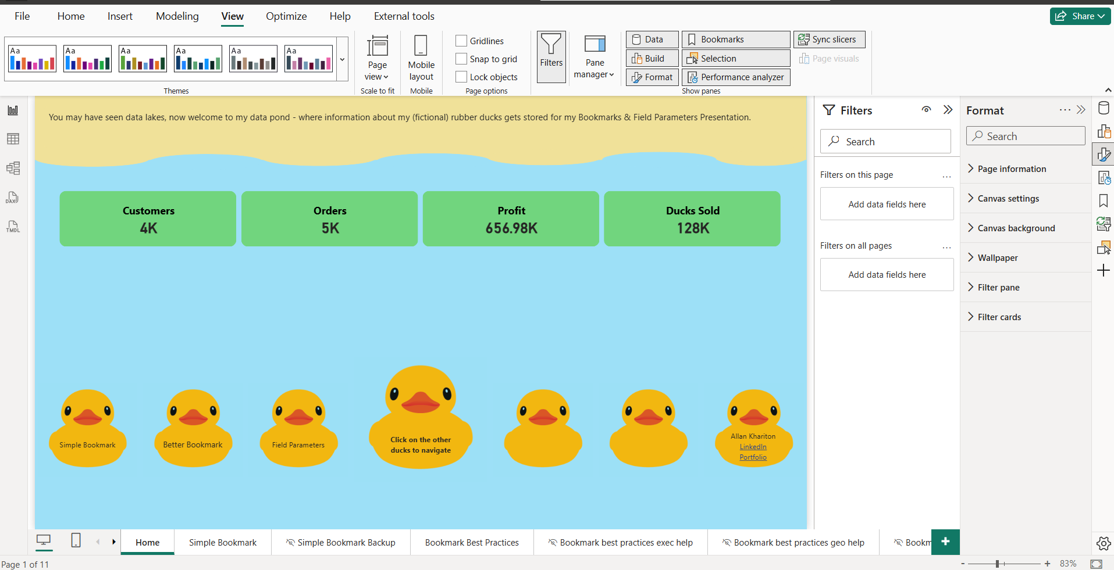
Selecting the Bookmark and Selection Pane
Go to “View” in the top nativation bar
Select “Bookmarks” and “Selection”
You will see those values on the righthand pane thereafter
1
2
3

Slide 12
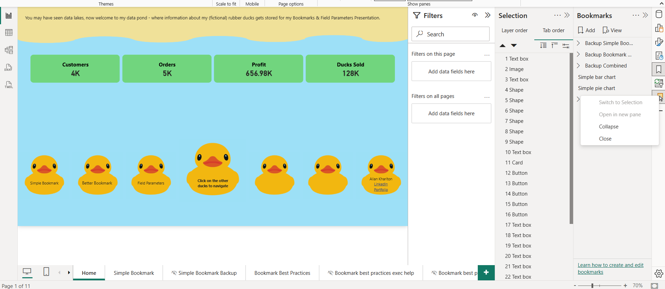
Opening the Bookmarks & Selection Panes
Select the “Bookmarks” icon on the right
Right click the “Selection” icon, and hit “Open in New Pane”
1
2

Slide 13
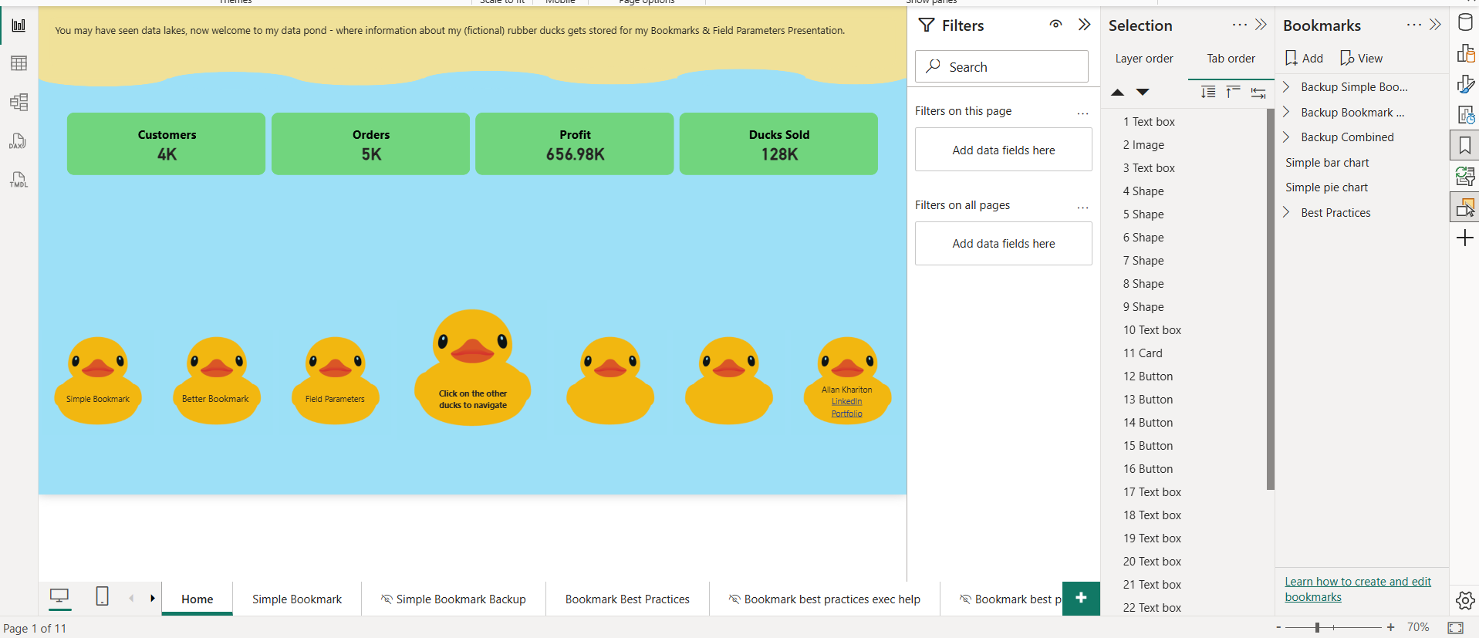
Creating a bookmark
Once you have your visuals/filters/etc as you’d like, go to the Bookmarks pane and hit “Add”
1

Slide 14
Grouping Visuals & Bookmarks: Benefits
Grouping visuals allows you to toggle the properties of those visuals more easily. Instead of, for example, making each individual visual visible/hidden, you can hit the group visibility icon and all the visuals will react accordingly. This is especially useful when working with multiple groups of visuals on the same page.
Grouping bookmarks allows you to more easily create a set of navigation buttons for users. In the button settings, you can select your bookmark group and only items in that group will appear for users to select. Otherwise, it will be more tedious to make sure only the desired bookmarks show up to the users as you edit your report.

Slide 15
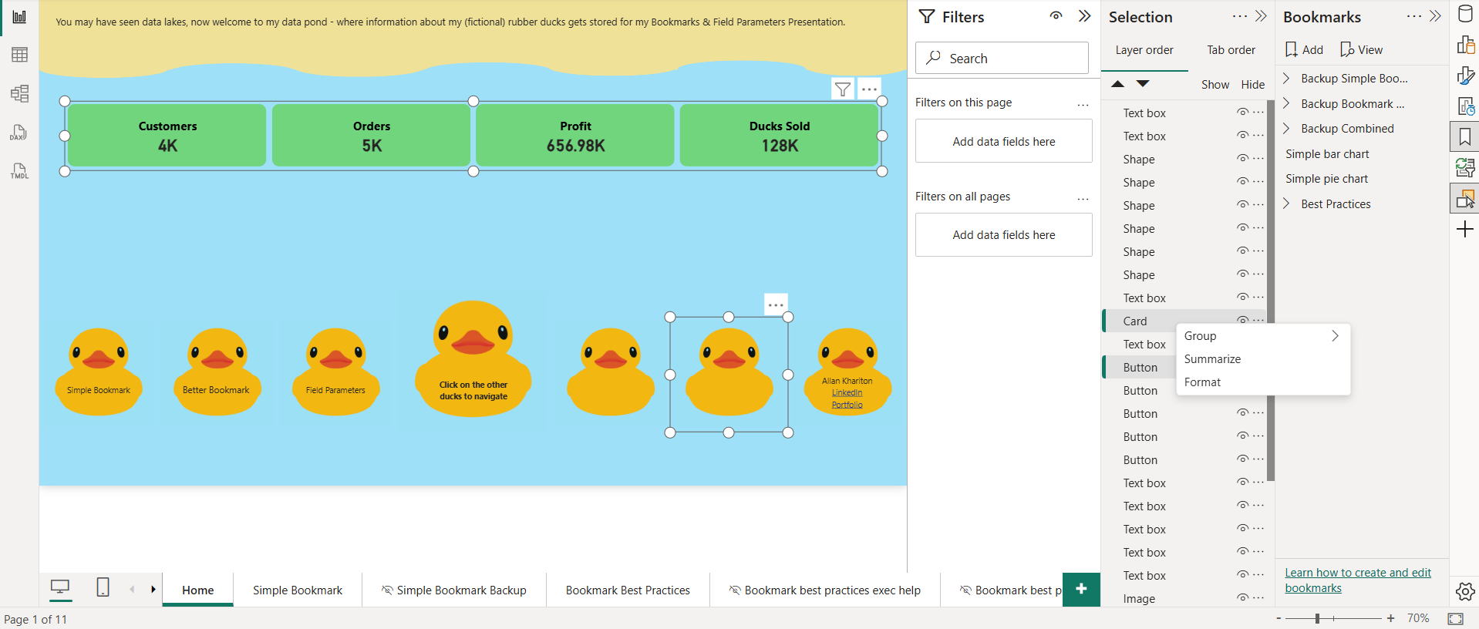
Grouping Visuals & Bookmarks
Make sure the selection pane is open
For any visuals you’d like to group, press ctrl + click on all the applicable visuals.
You will see these visuals highlighted in the Selection pane. Right click on one of these items in the Selection pane, and then hit Group
You can follow a similar process for bookmarks, by ctrl+clicking them in the Bookmarks pane and hitting group.
1
4
2
3

Slide 16
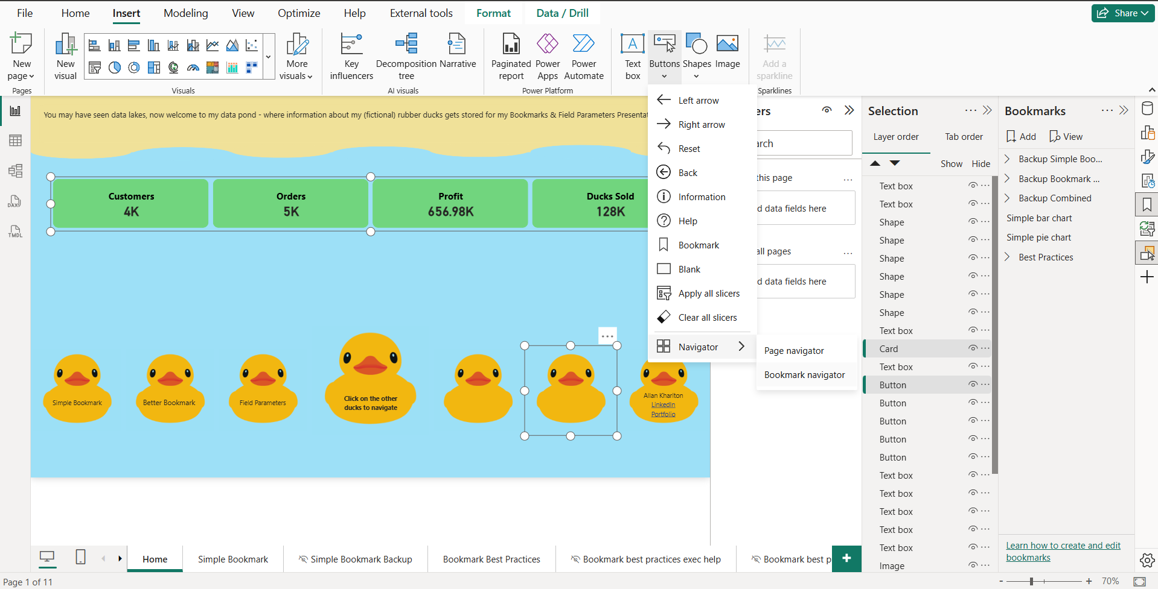
Adding a Bookmark Button for Users
After creating and grouping your bookmarks:
Name your bookmark group
Hit Insert in the top navigation menu
Hit buttons >> Navigation >> Bookmark Navigator
Once the button appears, go to its settings >> Bookmarks >> select your group name (see next slide)
2
3
1

Slide 17
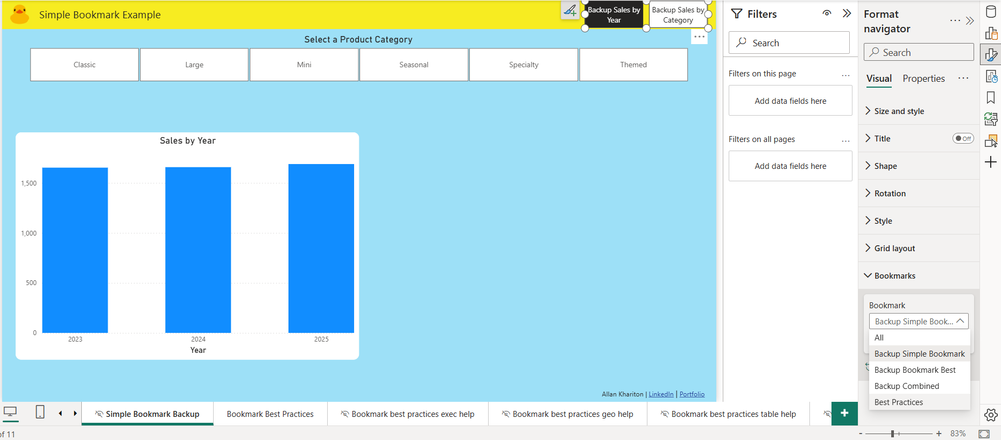
Adding a Bookmark Button for Users Pt 2
After creating and grouping your bookmarks:
Name your bookmark group
Hit Insert in the top navigation menu
Hit buttons >> Navigation >> Bookmark Navigator
Once the button appears, go to its settings >> Bookmarks >> select your group name (see next slide)
4

Slide 18
Accessing Bookmark Properties
To access bookmark properties, go to a bookmark and:
Hit the ellipses next to the bookmark line
View/Change settings
Data: If checked, then affected visuals will save with their selected data settings including sort order, cross highlighting, and filtering/selected data values.
Display: If checked, then affected visuals will save in their current visible/hidden state.
Current Page: If checked, then when the bookmark button is clicked the report will navigate to the current page you are on
All Visuals/Selected Visuals: If all visuals is selected, all visuals on the page will be “stored” and will revert to their current state when the bookmark is selected. If Selected Visals is selected, then only visuals that are selected will have their properties impacted by the bookmark (guide on next slide)

Slide 19
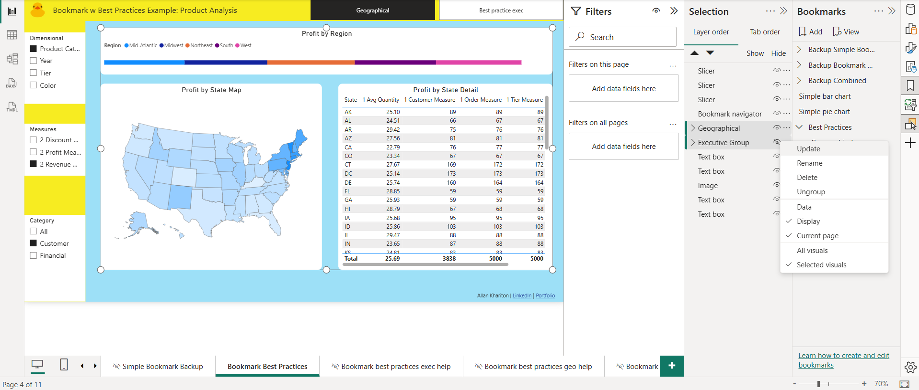
Selecting visuals for a bookmark
After creating your bookmark:
Go to your bookmark, and check the Selected Visuals property
In your Selection pane, ctrl + click the individual/groups of visuals. They will now be highlighted in the pane.
Make sure that visibility/other visual properties are as desired for the bookmark view
Hit Update on your bookmark
2
3
1

Slide 20
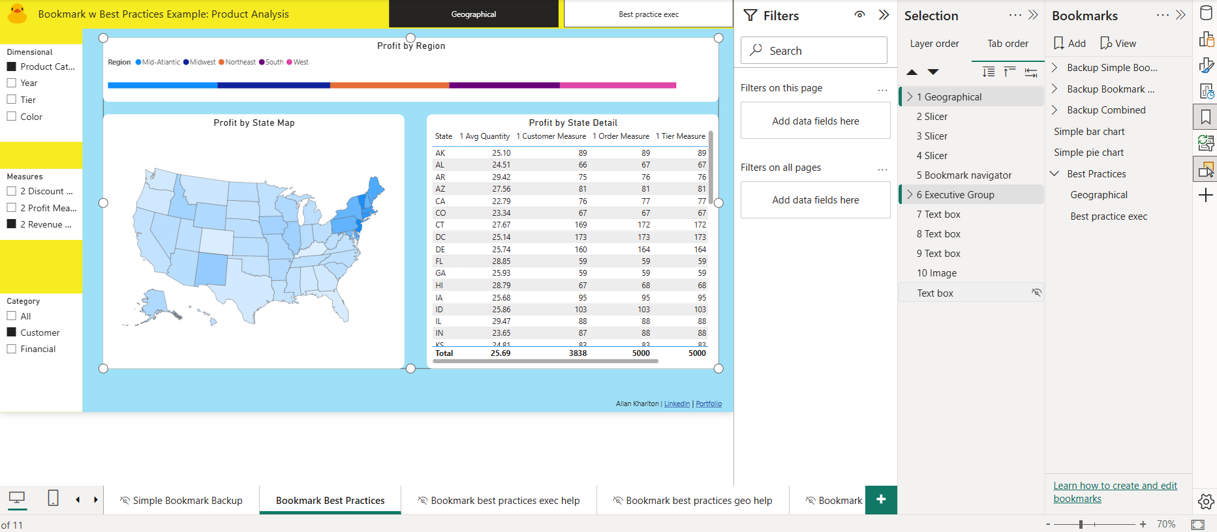
Accessibility Settings / Tab Order
After creating your page, use Tab Order for accessibility by:
Opening the Selection pane, and going to Tab Order
Ordering your visuals in the way you’d like a screen reader to go through them for users who need this feature
For any “non-relevant” visual – ie a decorative text box, or other item that is purely aesthetic and not adding value for a screen reader, un-check the visibility status for those items in the Tab Order pane
Also consider using accessible color palettes (abode has some) and icons that are more than just colored dots
1
2
3

Slide 21
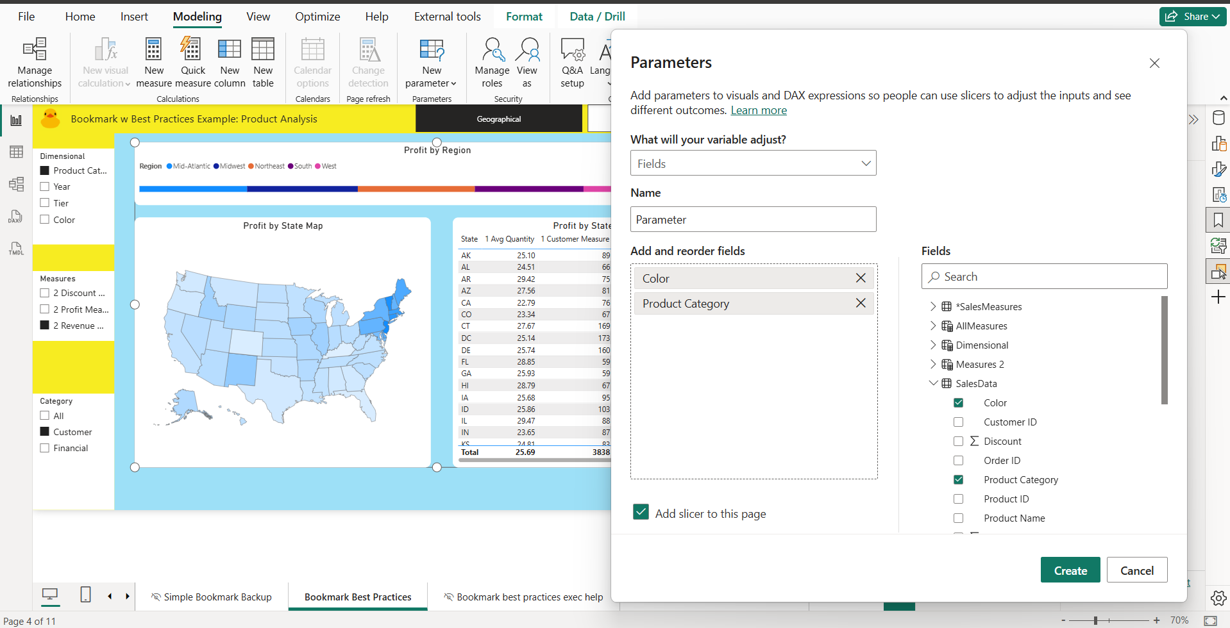
Creating a field parameter
After creating your bookmark:
Go to the Modelling tab of the Navigation Bar
Hit New Parameter >> Fields
Name the parameter and add the appropriate fields to the well
For parameters to change the axis (dimensional) categories, you must use columns
For parameters to change the value being measured (ie sum of sales, sum of revenue, etc), you must use measures
Hit Create
1
2
3
4

Slide 22
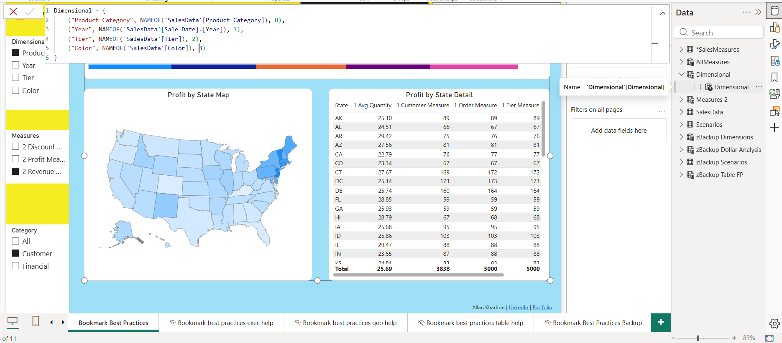
Modifying an existing parameter
After creating your bookmark:
Click on your parameter in the Data pane; its formula will appear in the formula bar
To change a parameter’s:
Display name: Change its name in the red quoted text on its line item
Dimension/measure: change the field, within the NAMEOF parens
Display order: change the numerical value at the end of the line
To add a new item, add a comma to the last field line item, copy/paste the prior item, and re-name/order the new item accordingly
2 & 3
1

Slide 23
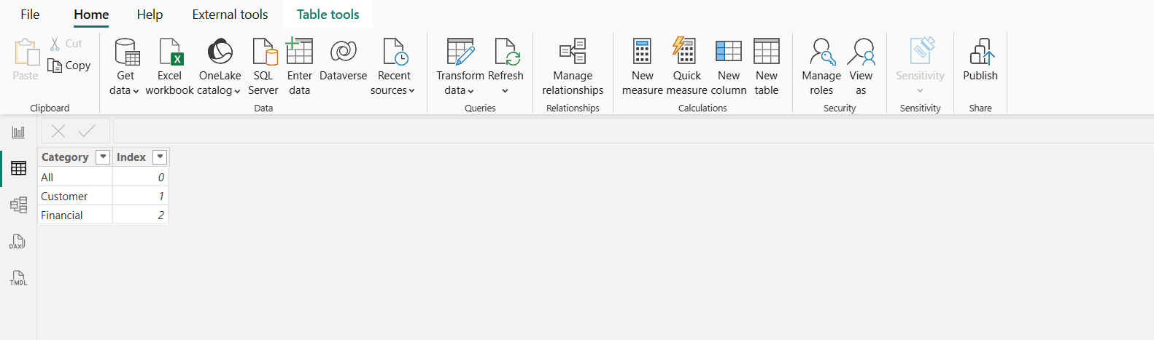
Grouping field parameter values Pt 1
Grouping field parameter values can allow multiple measures to be displayed on a chart. This is especially helpful for tables/matrices where you may want to flip between analyses easily – eg groups of related MoM, YoY, customer, etc:
Create a secondary table with your desired groupings
Either import your data, or go to the Tabular view, hit enter data, and create your Categories/Indices for your desired groups
In your field parameter, after the numeric value add a comma and the group name in quotation marks
Connect the new secondary table to the field parameter via the group name columns
Use the field parameter in your chart, and add the secondary table as a slicer to your page
Note: you can re-useitems in your parameter in multiple groups. Simply copy/paste the desired line items and then list the appropriate group name and numeric value to display
1
2 & 3

Slide 24
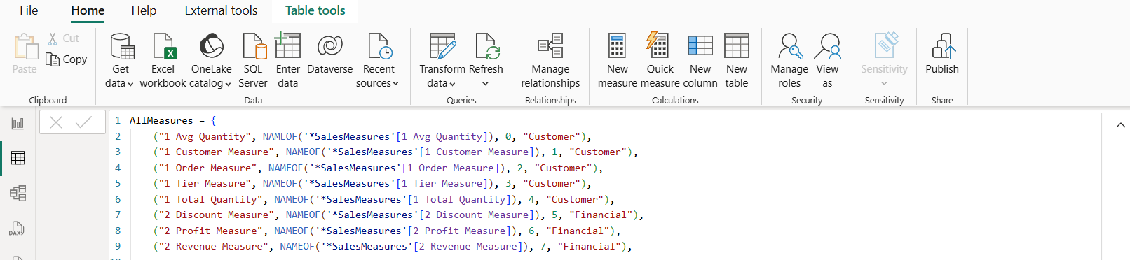
Grouping field parameter values Pt 2
In your field parameter, after the numeric value add a comma and the group name in quotation marks
Connect the new secondary table to the field parameter via the group name columns
Use the field parameter in your chart, and add the secondary table as a slicer to your page
Note: you can re-useitems in your parameter in multiple groups. Simply copy/paste the desired line items and then list the appropriate group name and numeric value to display
1

Slide 25
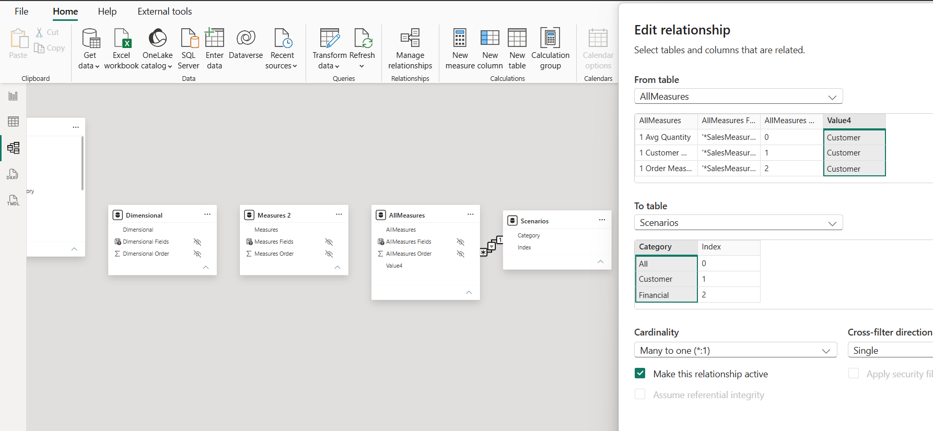
Grouping field parameter values Pt 3
Go to the model view
Connect the new secondary table to the field parameter via the group name columns
Use the field parameter in your chart, and add the secondary table as a slicer to your page
Note: you can re-use items in your parameter in multiple groups. Simply copy/paste the desired line items and then list the appropriate group name and numeric value to display
1
2

Slide 26
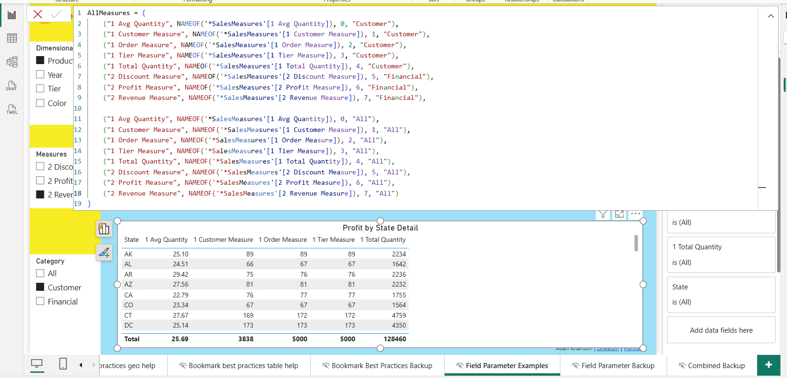
Grouping field parameter values Pt 4
Use the field parameter in your chart
Add the secondary table as a slicer to your page
Now as seen in the below & provided BI file, users can select either All measures, Customer measures, or Financial measures to view easily via the slicer + parameter table combination.
Note: you can re-use items in your parameter in multiple groups. Simply copy/paste the desired line items and then list the appropriate group name and numeric value to display
Note
2
1

